Slide 1
Who is a True Fan?
Team Sakai@Midnight
Lei Qian, Leo Shu, Fu Wen, Sheila Xin, and Jane Yu
Department of Statistical Science
Duke University
DataFest Spring 2016

Slide 2
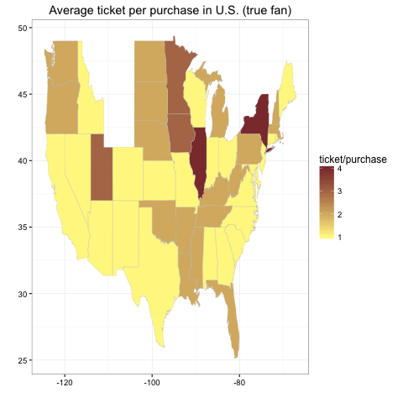
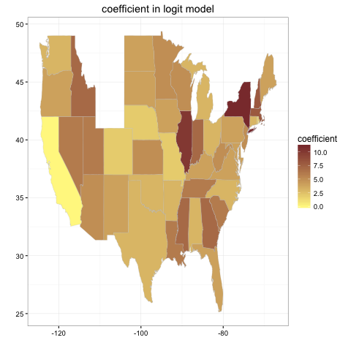
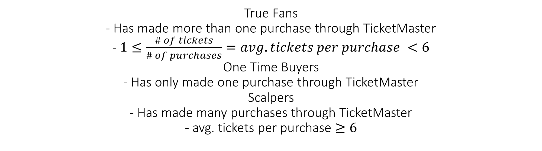
True Fans
- Has made more than one purchase through TicketMaster
- $1≤\frac{\# of tickets}{\# of purchases}=avg. tickets per purchase <6$
One Time Buyers
- Has only made one purchase through TicketMaster
Scalpers
- Has made many purchases through TicketMaster
- avg. tickets per purchase $≥6$

Slide 3
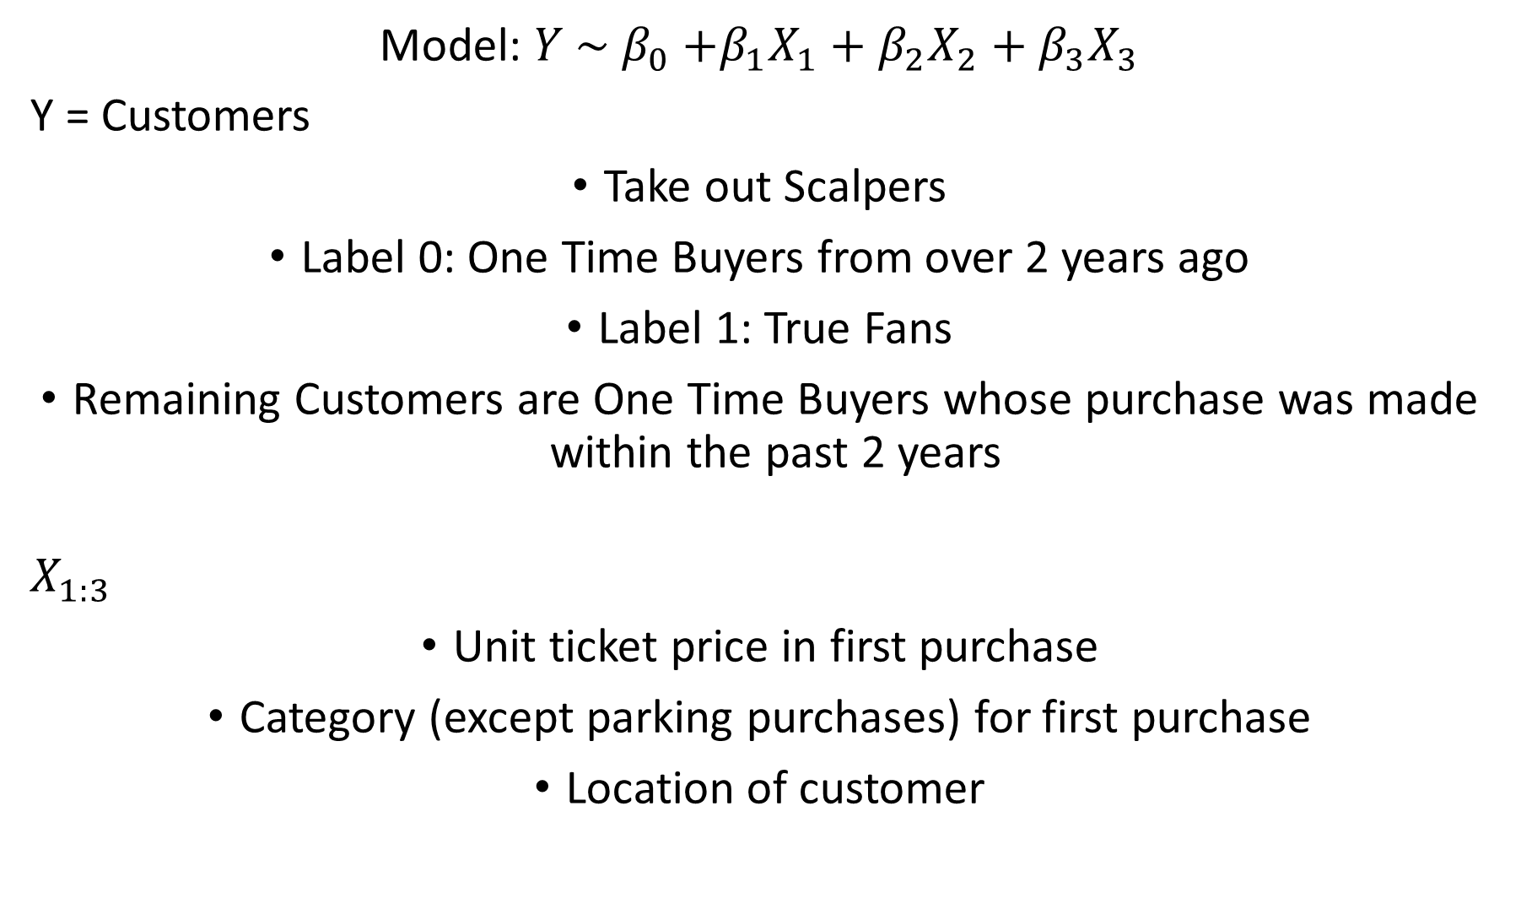
Model: $Y \sim β_{0}$ $+β_{1}X_{1}+β_{2}X_{2}+β_{3}X_{3}$
Y = Customers
Take out Scalpers
Label 0: One Time Buyers from over 2 years ago
Label 1: True Fans
Remaining Customers are One Time Buyers whose purchase was made within the past 2 years
$$X_{1:3}$$
Unit ticket price in first purchase
Category (except parking purchases) for first purchase
Location of customer

